Slide 1




Slide 2

AMERICAN JETSTREAM PRE-INTERMEDIATE B

Slide 3
TEACHER’S PERSONAL INFORMATION
Name: Nguyen Thanh Loan
Facebook: Loan Nguyễn Thanh
Mobile number: 0942 255 937
Email: loannguyenthanh1978@gmail.com
* Zalo lớp: DH20TD-TA3B-010112284425

Slide 4
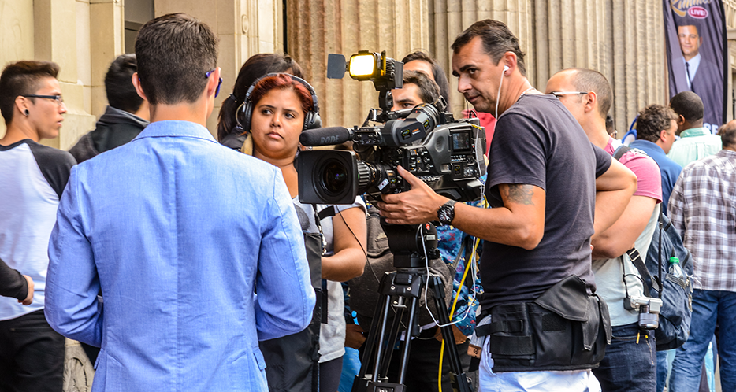


UNIT 10
The news and journalism

Slide 5
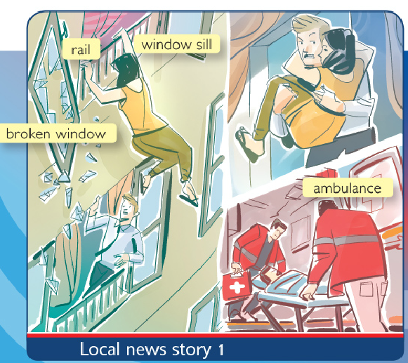
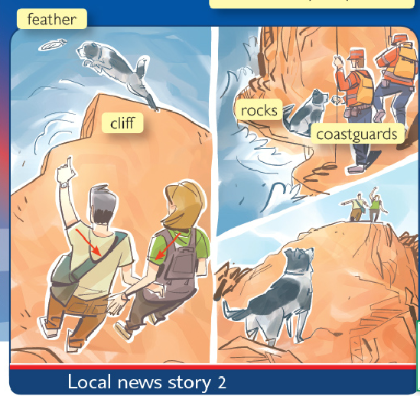
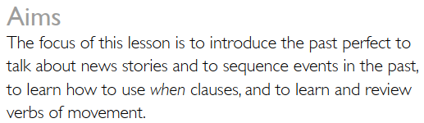
LESSON 1
She had fallen through a window!

Slide 6
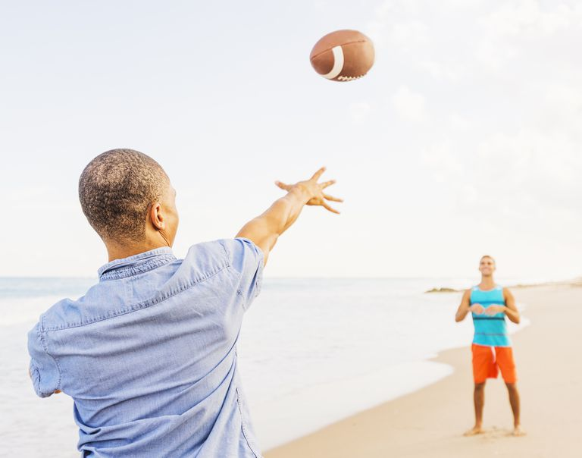
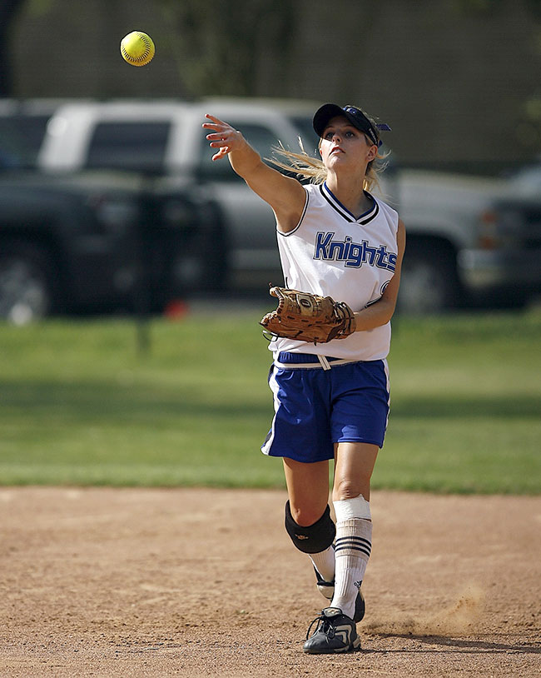
VOCABULARY
VERBS OF MOVEMENT
throw a ball
Use your hand to send a ball or an object through the air
/θrəʊ/
Ex: My friend threw the ball back over the fence.

Slide 7
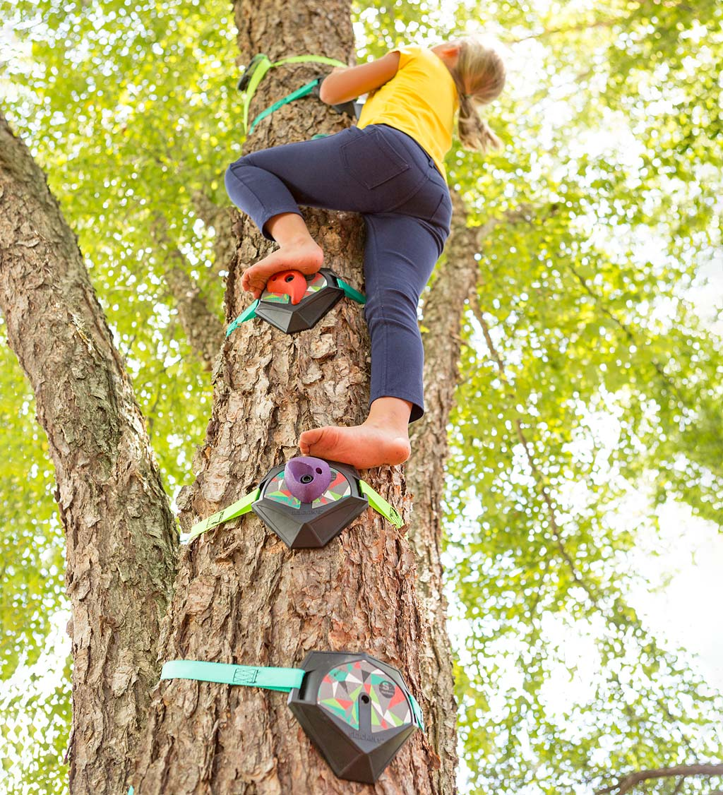
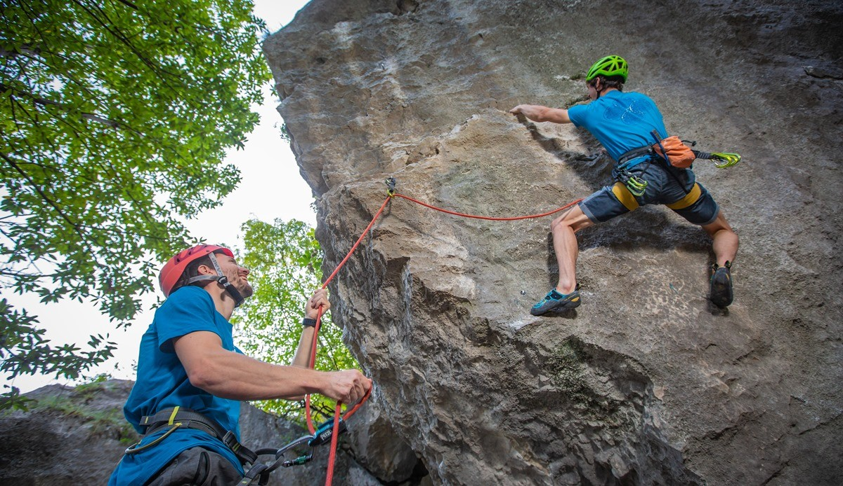
VOCABULARY
VERBS OF MOVEMENT
climb
Use your hands and feet to move up something
/klaɪm/
Ex: I hate climbing ladders.

Slide 8

VOCABULARY
VERBS OF MOVEMENT
Pull & push
Move something towards you
/pʊl/ /pʊʃ/
Move something into a different position.

Slide 9
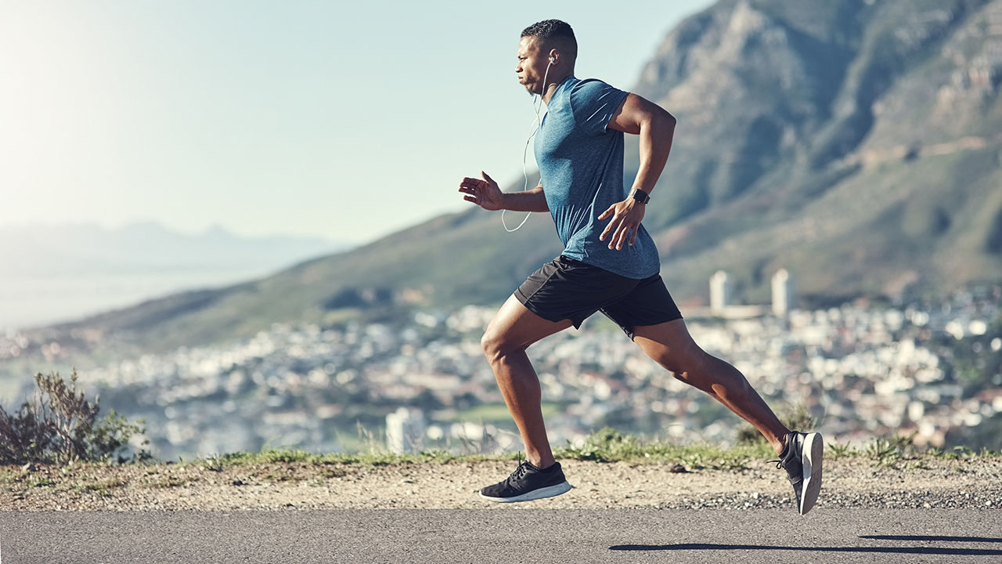
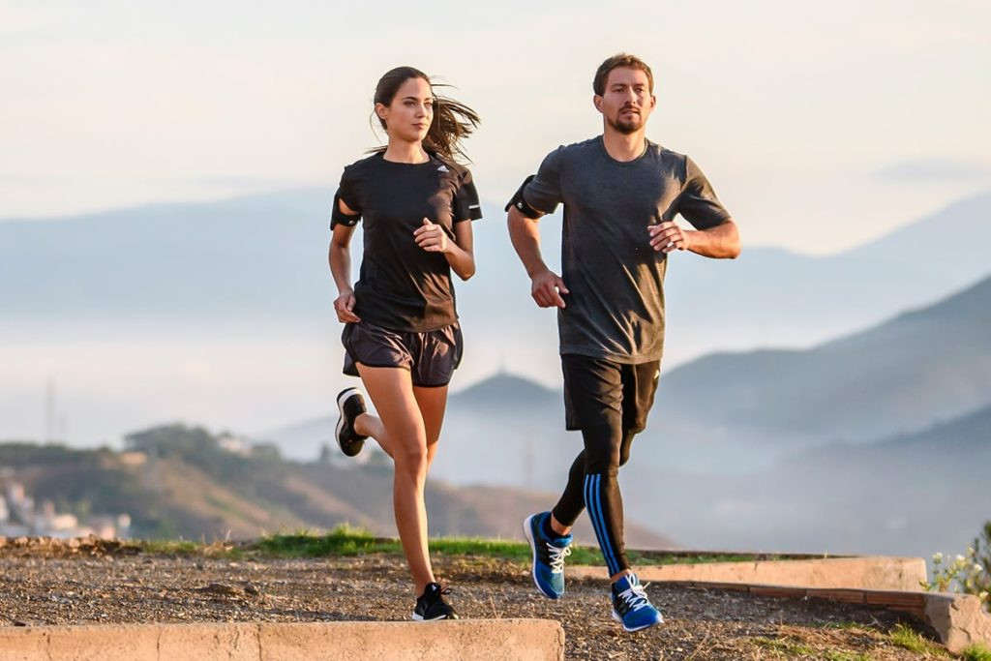
VOCABULARY
VERBS OF MOVEMENT
running
Using your legs to move quickly.
/ˈrʌn.ɪŋ/
Ex: They won the trophy for the third year running.

Slide 10
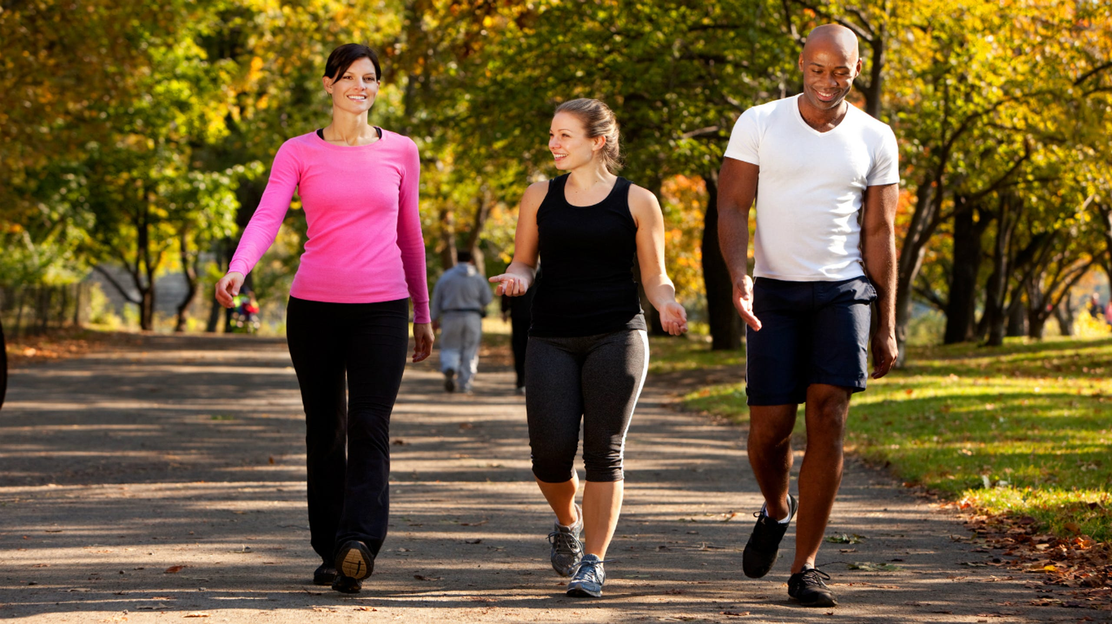
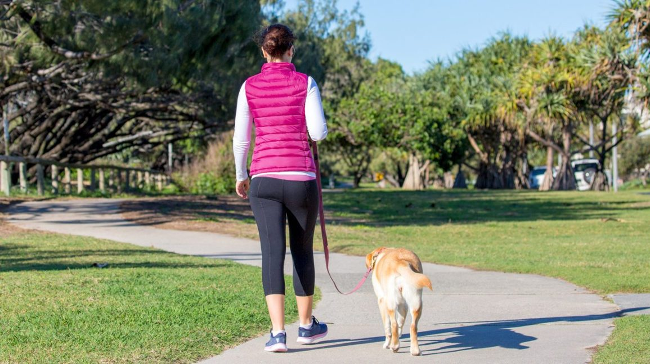
VOCABULARY
VERBS OF MOVEMENT
walking
Using your legs to move around.
Ex: We're going walking in the park after work.

Slide 11


VOCABULARY
VERBS OF MOVEMENT
carry
Hold something in your hands and take it somewhere.
/ˈkær.i/
Ex: Would you like me to carry your bag for you?

Slide 12
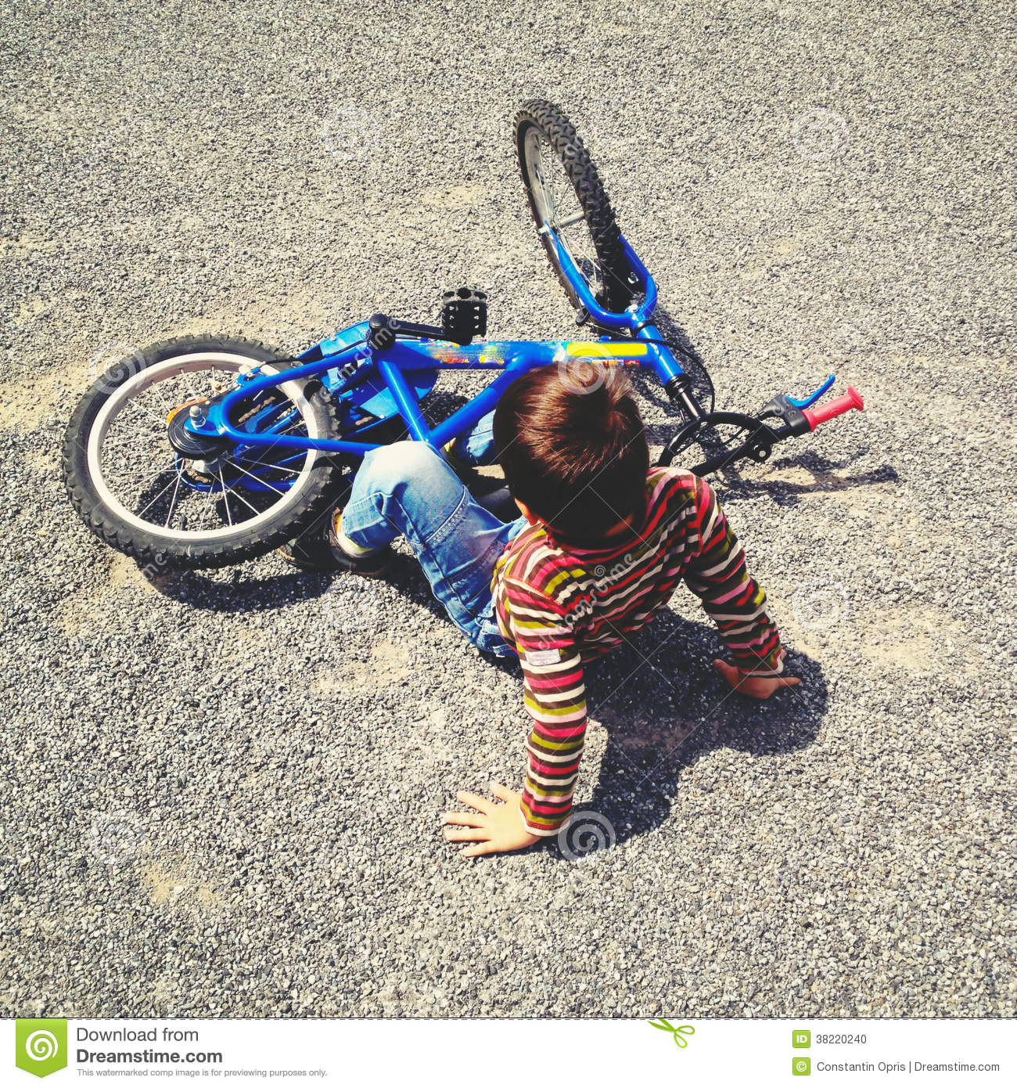
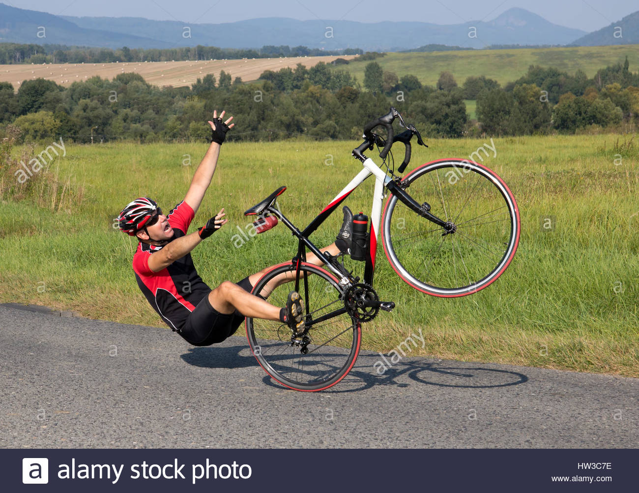
VOCABULARY
VERBS OF MOVEMENT
Fall off a bike
Move quickly down to the ground from an object, often by accident.
/fɔːl/
Ex: Sales have been falling off recently.

Slide 13

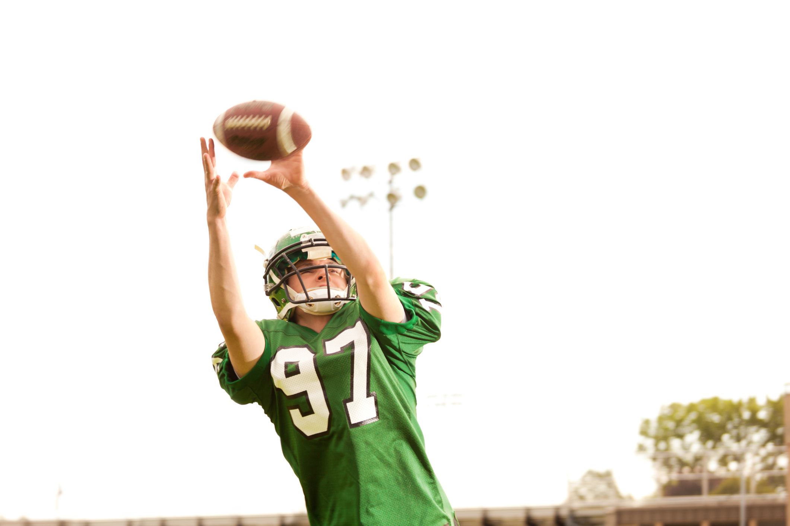
VOCABULARY
VERBS OF MOVEMENT
catch
Stop something from moving through the air using your hands.
/kætʃ/
Ex: I managed to catch the glass before it hit the ground.

Slide 14


VOCABULARY
VERBS OF MOVEMENT
hang on
fix something to a wall.
/hæŋ/
Ex: she is hanging some pictures on the wall.

Slide 15

SPEAKING
Getting your news
Think about the news and these questions.
How do you get your news everyday? Do you read it online, watch TV, listen to the radio, or buy a newspaper?
Is the news important to you? Do you need to know the latest news each day?
https://www.youtube.com/watch?v=D7Bazj4X9i8

Slide 16
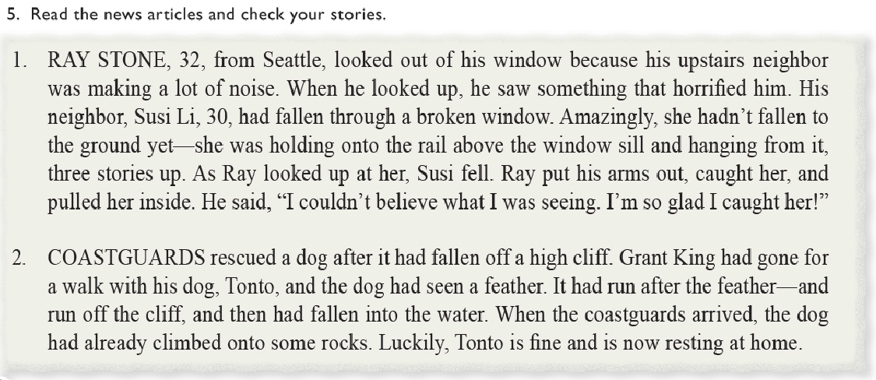
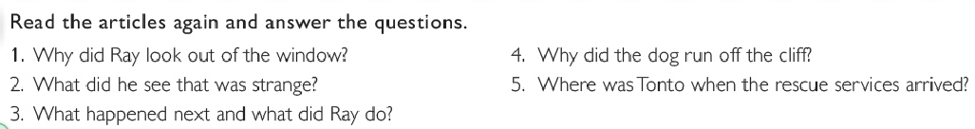
READING

Slide 17
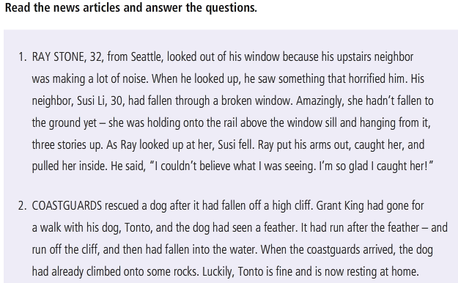
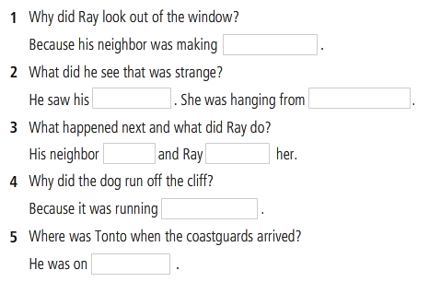
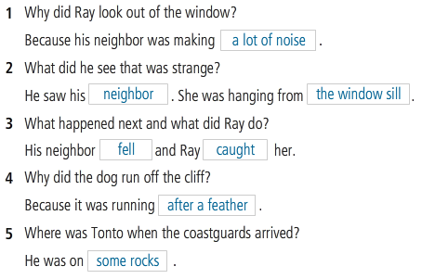
READING

Slide 18
GRAMMAR
PAST PERFECT TENSE
Look at the sentences from the news and answer the questions.
1. Coastguards rescued a dog after it had fallen off a high cliff.
2. When the coastguards arrived, the dog had already climbed onto some rocks.
Which action happened first in the past?
Which tense do we use to show that one action happened before another in the past ?
How is the tense formed?

Slide 19
GRAMMAR
PAST PERFECT TENSE
Form
(+) Subject + had + Past Participle (P2)
(-) Subject + hadn’t + Past Participle (P2)
(-) Had + Subject + Past Participle (P2) ?
Examples
(+) When I returned with my camera, the bird had flown away.
(-) When I arrived, they hadn’t started.
(?) Had they gone when you came home?
https://www.youtube.com/watch?v=X-pLTIafYWM

Slide 20
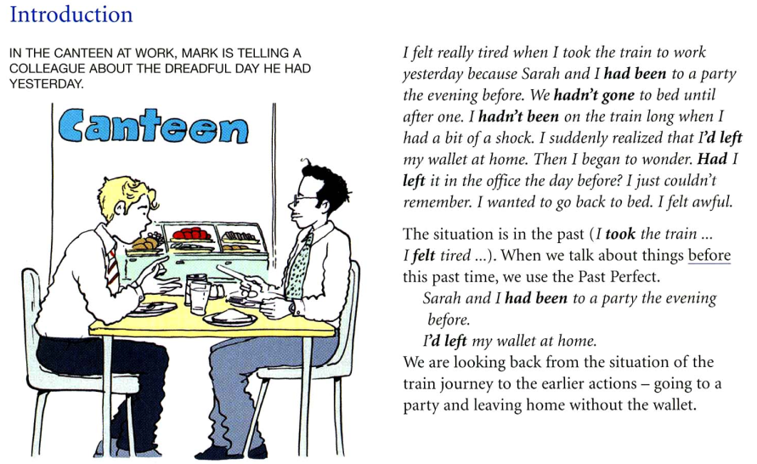
GRAMMAR
PAST PERFECT
TENSE

Slide 21
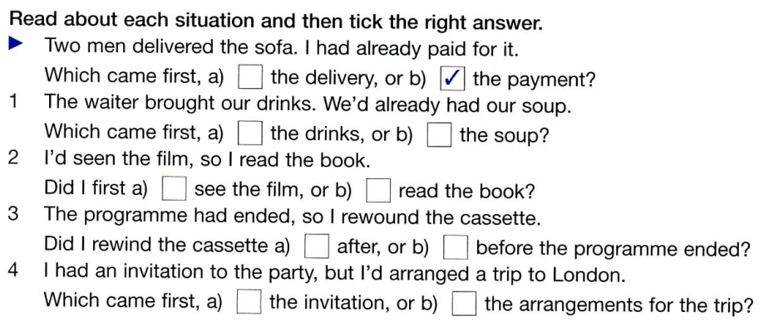
GRAMMAR
PAST PERFECT TENSE

Slide 22
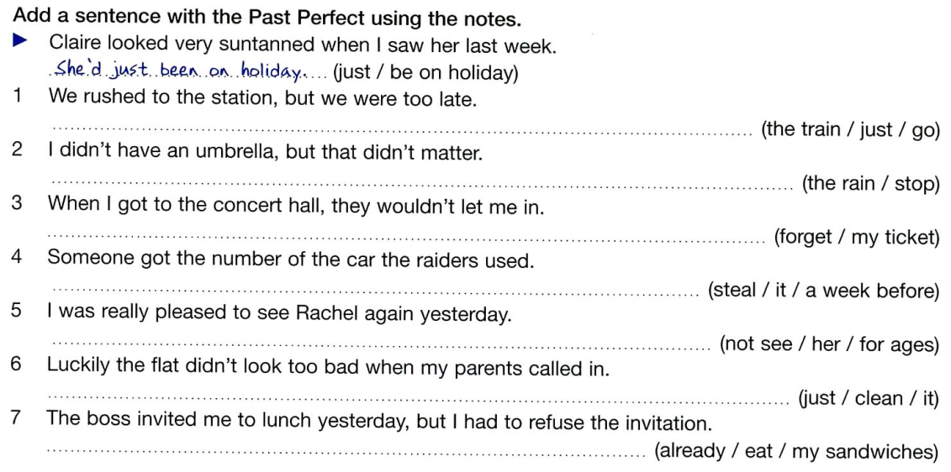
GRAMMAR
PAST PERFECT TENSE

Slide 23
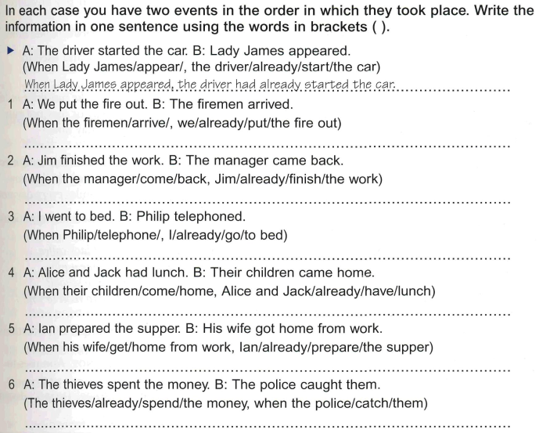
GRAMMAR
PAST PERFECT
TENSE

Slide 24
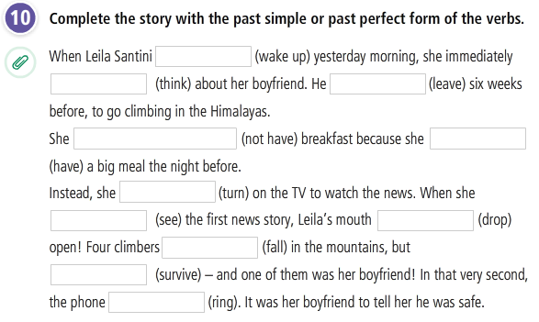
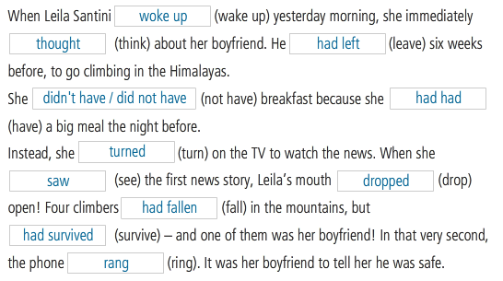
GRAMMAR PRACTICE
PAST PERFECT TENSE

Slide 25
REFERENCES
Vocabulary exercises
https://www.esl-lounge.com/student/vocabulary/1v61-elementary-verbs-of-movement-gap-fill-quiz.php
Grammar: Past perfect tense
https://www.youtube.com/watch?v=XjS8xPRtjlc
Grammar: Past perfect exercises
https://www.youtube.com/watch?v=2JmEL-JBe58
https://www.youtube.com/watch?v=50NeuUzr83s
Listening and speaking
https://www.youtube.com/watch?v=-TrE6VdtgLE

